Slide 1







PREDICTION OF SALES: CLASSIFICATION WITH RANDOM FOREST
Application of Machine Learning
Get Started

Slide 2


01.
02.
03.
Objectives
Solution
Business Impact
content.
Table of

Slide 3


Objectives
Problem statement: A cloth manufacturing company is interested to know about the segment or attributes that cause high sales.
Objective: The main purpose of the project is to predict sales categories (High, Moderate or Low) based on attributes like Competitor Price, Income, Advertising, Population, Price, Shelf Location at stores, Age, Education, Urban and U.S., using Random Forest Classifier.

Slide 4
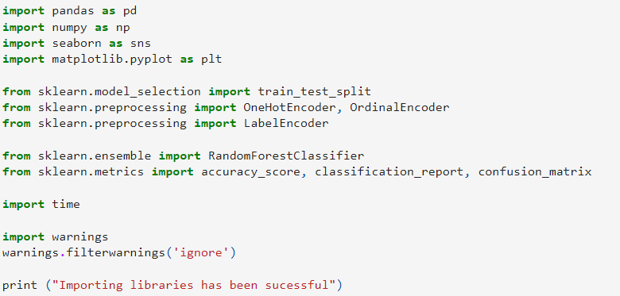
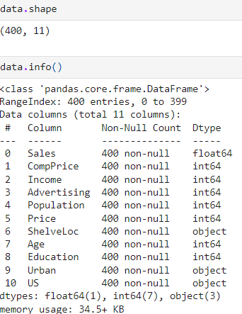
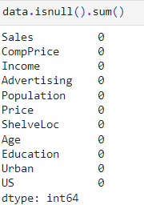
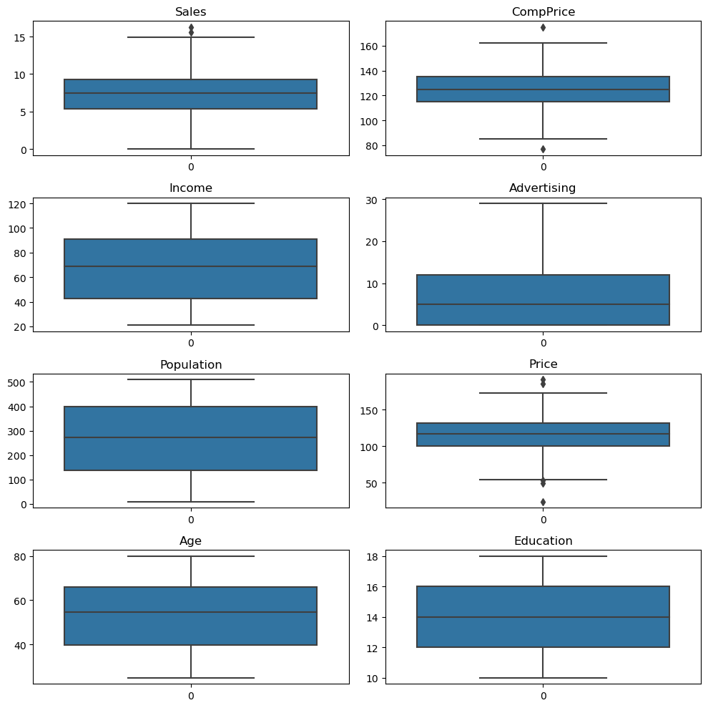
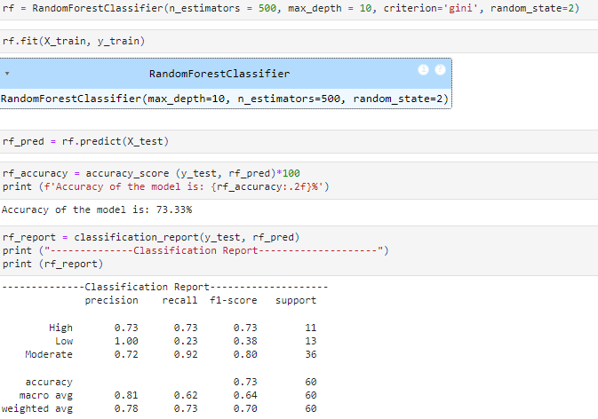
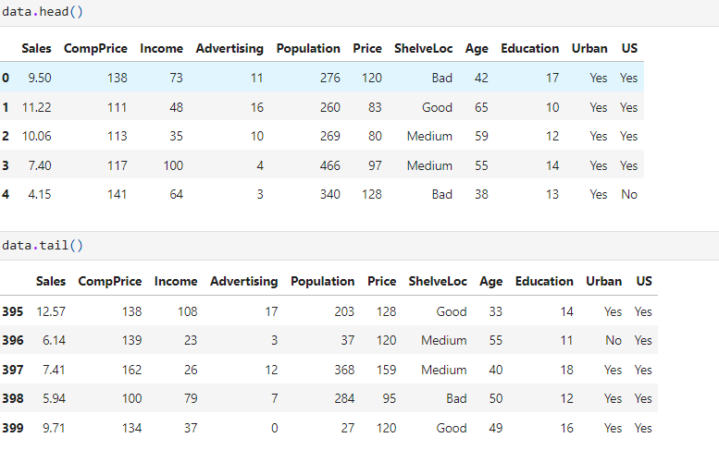
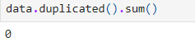
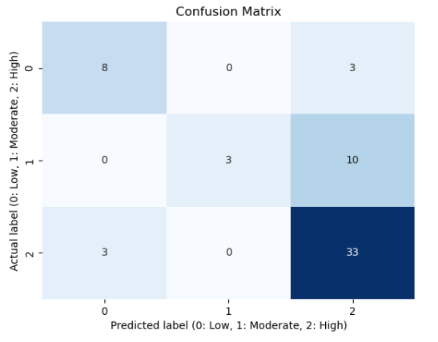
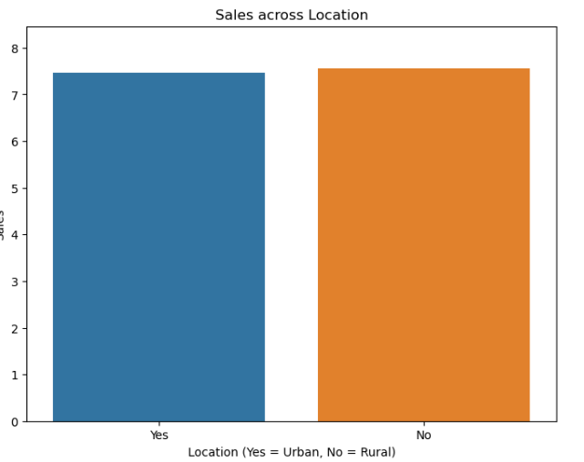
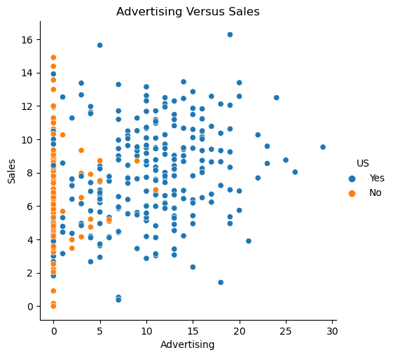
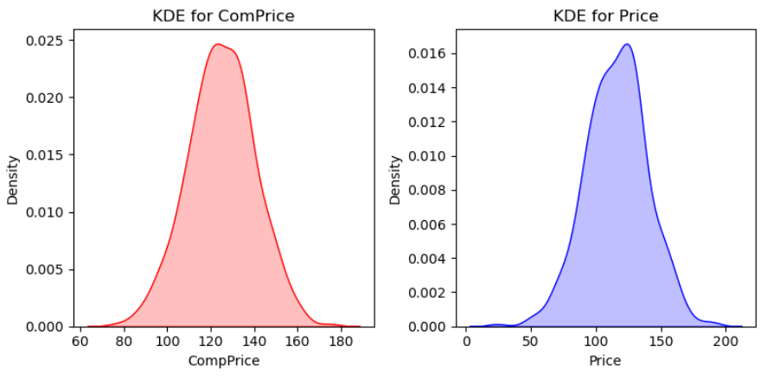
Solution
Libraries importing
Data Loading
Data Exploration
Data Preprocessing
EDA
Model development

Slide 5



Prediction of Sales
The company can estimate sales across their stores
Evaluation of Marketing effectiveness
Business Impact
Evaluation of effectiveness of marketing campaigns can be possible in the context of whether the marketing efforts have positive influenced sales of the company.
Competitive price estimation
The company can formulate an optimized price point to maintain a competitive advantages in the marketplace

Slide 6

Thank
You.

